Slide 1
House Teams

Slide 2
The House System
We use a House System across the school to promote the notion of how we operate as a TEAM at King’s Hill.
The House System upholds the values and ethos of our school and provides all of you opportunities to become involved in team events / activities and gain life skills to support you as you grow.

Slide 3
The House System
By taking part in the House System you gain attributes which reflect our school expectations:
Teamwork
Achievement
Challenge / competitiveness
Leadership
Individual / collective responsibility
Confidence
Communication Skills
Flexibility and resilience

Slide 4
House Points/Dojos
House points form part of the whole school reward system.
House points encourage a team ethos across the school and allow pupils of all ages to have a common goal.
Every pupil, from Year 1 to Year 6, are sorted into one of the four houses
You will be in the same house as your brothers and sisters

Slide 5
How they are gained?
House points can be gained through the participating in team events, through the different house tournaments and your dojos in class.
Can anyone remind us what you can earn a dojo for?

Slide 6
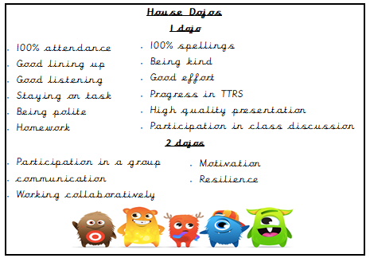

Slide 7
The Houses
AQUA – blue – Mrs Bahia
IGNIS – red – Mrs Kemshall
TERRA – green – Miss Roberts
VENTUS – yellow – Mrs Taheir

Slide 8
The theme for this year is Emergency Response Services

Slide 9
House Captains
We will have four house captains from year 6.
We will have four vice house captains from year 5.
The House Captains and vice captains will introduce themselves in one of your assemblies very soon, once they have been chosen.

Slide 10
Roles and responsibilities of captain and vice captain Display in hall for winners, set up competitions, share results in assemblies, take part in assemblies, help on sports day, helping on competitions, promotion of charities, gathering feedback on charity days, introduce house system to year one

Slide 11
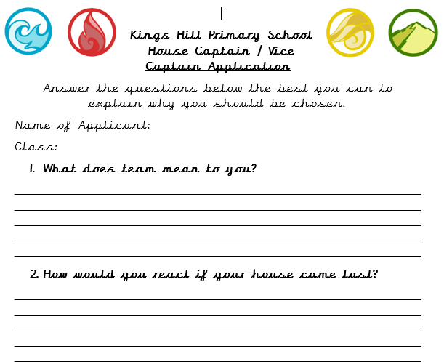
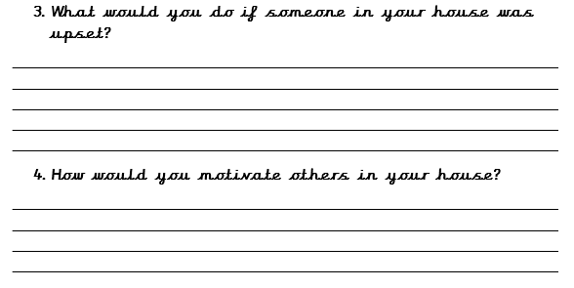
How to apply

